Slide 1

Introduction to Robotics
2016 Fall

Slide 2
The Software Development Process
Developing software may seem like a difficult task, but it follows a process that will enable you to be successful in creating your programs for the mBot.
The process generally consists of five major steps:
1. Requirements
2. Analysis
3. Design
4. Implementation
5. Testing and Debugging
There are many ways to approach software development, but unless you are just hacking away at a program you will find that spending some time with each of these steps will decrease the amount of time required to be successful in your development efforts.

Slide 3
Requirement
Requirements:
1. What the program must do, such as turning on an LED, making sounds, or solving a maze.
2. They also provide a means for the developer to demonstrate that the program is complete.
3. There are many ways to define requirements, but a good general rule of thumb is limit each requirement to a single thought or capability.

Slide 4
Analysis
1. Analysis is the process of reading and understanding the requirements so that you can identify what you will need to do to perform the work associated with those requirements.
2. Analysis also allows you to identify what other things need to be done to support the design for the implementation of the requirements, such as whether or not you need to connect with other systems or if you need to do the work within a particular period of time.

Slide 5
Design
Design is the process of determining how that you will implement the requirements based on the results of your analysis. This point in the development process is where you design the program logic
in detail.
Note: Analysis answers what needs to be done and Design answers how does it need to be done. The two are often intermingled which can lead to errors. Make sure that you take the time to understand what before diving into how.

Slide 6
Implementation
At this point of the process, you are actually writing the code and test code for your application as well as updating your design and/or analysis documents if you discover that you have missed
something.

Slide 7
Testing and Debugging
This final phase of the development process ensures that your application works as intended and fulfills the requirements. If it is not working correctly, this phase is where you would spend time
debugging the errors in your code.
As with implementation, if you discover something that was not originally seen in your analysis or design, you need to go back and update those items so that the final code will match them.

Slide 8
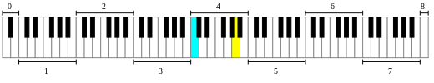
Project: Play an Octave
The mBot has a built-in buzzer that can play different tones
C4
A4

Slide 9
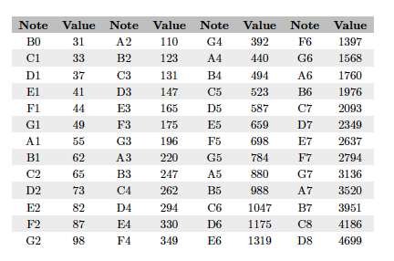
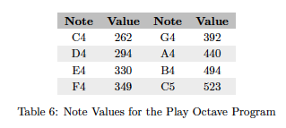
Requirements
1. Play an eight-note scale from C4 to C5.
2. Each note shall be a quarter note.
Analysis
mBlock can play tones in certain frequencies

Slide 10
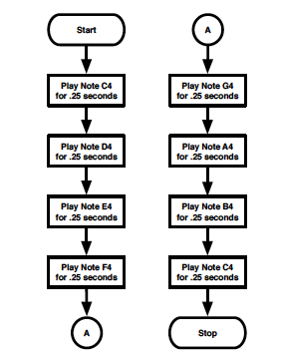
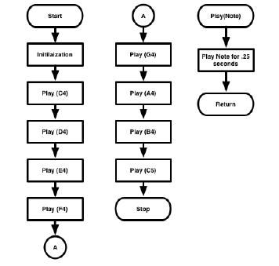
Design

Slide 11
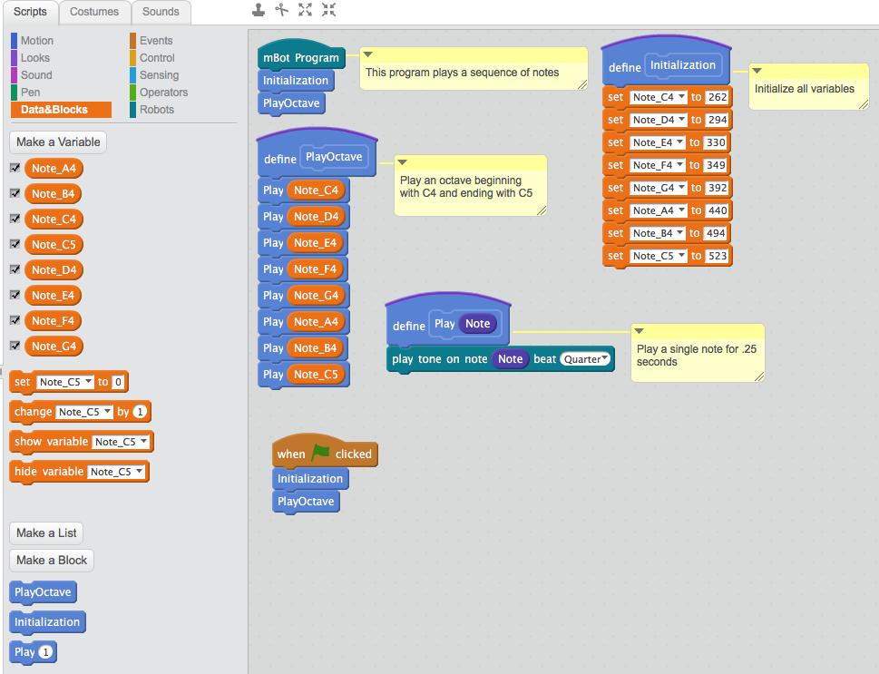
Implementation

